Slide 1


Chapter Three
Labour Supply and Public Policy: Work Incentive Effects of Alternative Income Maintenance Programs
Prepared by Dr. Mir Ahasan Kabir
York University

Slide 2
Learning Objectives
Discuss key features of different types of income maintenance programs, including demogrants, social assistance, unemployment insurance, wage subsidies, worker’s compensation, and childcare subsidies.
Using the labour supply model, analyze and compare the work incentive effects of demogrants, social assistance programs, and wage subsidies.
Using the labour supply model, analyze the work incentive effects of unemployment insurance. Discuss key challenges to estimating effects of the program on individual behaviour.
© 2021 MCGRAW-HILL EDUCATION LTD.
3 - <number>

Slide 3
Learning Objectives
Graphically illustrate the effect of a disability on the budget constraint. Discuss how well-being can be compared across disability compensation programs.
Illustrate how child care requirements affect the budget constraint and how programs to subsidize care can affect labour supply decisions.
© 2021 MCGRAW-HILL EDUCATION LTD.
3 - <number>

Slide 4
Main Questions
Can the myriad government transfer programs in Canada be analyzed in a common framework? If so, is there a way to determine the “best” type of income transfer program, at least in terms of its effects on work incentives?
Does unemployment insurance unambiguously reduce incentives to work, thereby reducing overall employment?
Can welfare programs be designed in a way that minimizes adverse work incentives, directing benefits to those who most need it?
How can we incorporate disabilities into the labour supply model? Can workers’ compensation reduce the incentive of injured workers to return to work?
How do childcare subsidies encourage the labour force participation of women? How can childcare costs be incorporated into the labour supply model?
© 2021 MCGRAW-HILL EDUCATION LTD.
3 - <number>

Slide 5
Income Maintenance Programs
Designed to supplement low incomes, which can arise from a various number of reasons
No single program can address the multiple reasons for low income
© 2021 MCGRAW-HILL EDUCATION LTD.
3 - <number>

Slide 6
Income Maintenance Programs
Table 3.1 Government transfers received by Census Families in Canada, 2017
Benefits: | Percent of families | Average Amount
All government transfers (federal and provincial) | 83.7% | $12,750
Federal Child Benefits | 20.2% | $6,314
Provincial Child Benefits | 10.6% | $1,941
Employment Insurance | 14.0% | $8,352
Social Assistance | 11.3% | $8,367
Workers’ Compensation | 3.5% | $9,820
Canada/Quebec Pension Plan | 32.4% | $10,092
Old Age Security | 25.1% | $8,566
Guaranteed Income Supplement | 9.6% | $6,634
© 2021 MCGRAW-HILL EDUCATION LTD.
3 - <number>

Slide 7
Income Maintenance Programs
Universal Programs vs. Targeted Programs
Universal Programs
  Administratively simple
  Everyone receives the same transfer regardless of income
  Expensive
  Also benefits nonpoor
© 2021 MCGRAW-HILL EDUCATION LTD.
3 - <number>

Slide 8
Income Maintenance Programs
Targeted Programs
  Cheaper method
  Individuals are given exactly enough of a transfer to reach the poverty line
  Only those below poverty line would receive transfer
  Creates a disincentive to earn income and, hence, may cause individuals to reduce work effort
© 2021 MCGRAW-HILL EDUCATION LTD.
3 - <number>

Slide 9
Income Maintenance Programs
Permanent or Transitory?
  Compensating low wages or shortage of hours worked?
  Low income may be due to the shortage of hours worked or low wage rate:
    Shortage of hours is mainly associated with the loss of transitory income (needs transitory type policy)
    Low wage rate, on the other hand, may represent permanent low income (needs permanent type policy)
Difficult to isolate permanent from transitory
© 2021 MCGRAW-HILL EDUCATION LTD.
3 - <number>

Slide 10
Demogrants, Welfare, and Wage Subsidies
Demogrants
Lump sum transfer or income grant (universal)
Specific to a demographic group
  Old Age Security (OAS): Providing monthly benefits to people aged 65 and over
  Former Universal Child Care Benefit (UCCB) program
© 2021 MCGRAW-HILL EDUCATION LTD.
3 - <number>

Slide 11
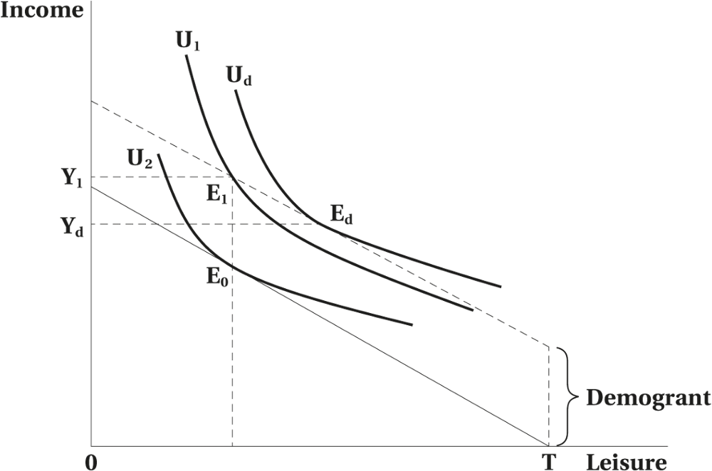
Demogrants, Welfare, and Wage Subsidies
Figure 3.1 Work Incentive Effects of a Lump-Sum Demogrant
© 2021 MCGRAW-HILL EDUCATION LTD.
3 - <number>

Slide 12
Demogrants, Welfare, and Wage Subsidies
Work Incentive Effects of a Lump-Sum Demogrant
No substitution effect
Work incentives are reduced
Pure leisure-inducing income effect
Increase in income is less than the amount of demogrant (all or a portion of the demogrant is used to buy leisure)
© 2021 MCGRAW-HILL EDUCATION LTD.
3 - <number>

Slide 13
Demogrants, Welfare, and Wage Subsidies
Welfare
Administered by the provinces
Financed partly by the federal government
Benefits depend on:
  Needs of the family
  Assets
  Other sources of income
© 2021 MCGRAW-HILL EDUCATION LTD.
3 - <number>

Slide 14
Demogrants, Welfare, and Wage Subsidies
Table 3.2 Income of Welfare Recipients by Province, 2018 (lone parent, one child)
Province | Annual Incomeª ($) | Income as % of Poverty Line^{b}
Newfoundland | 23,436 | 85
Prince Edward Island | 20,977 | 77
Nova Scotia | 18,240 | 67
New Brunswick | 19,978 | 78
Quebec | 21,867 | 86
Ontario | 21,463 | 72
Manitoba | 21,764 | 82
Saskatchewan | 21,087 | 77
Alberta | 19,927 | 68
British Columbia | 20,782 | 71
Average (unweighted) | 20,952 | 76
© 2021 MCGRAW-HILL EDUCATION LTD.
3 - <number>

Slide 15
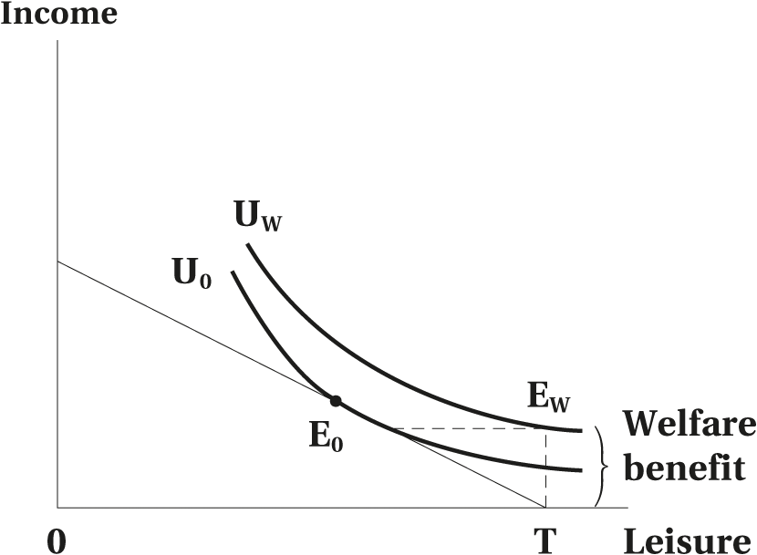
Demogrants, Welfare, and Wage Subsidies
Figure 3.2 Work Incentive Effects of a Welfare Benefit with 100 Percent “Clawback”
© 2021 MCGRAW-HILL EDUCATION LTD.
3 - <number>

Slide 16
Demogrants, Welfare, and Wage Subsidies
Work Incentive Effects of a Welfare Benefit with 100 Percent “Clawback”
Adverse effect on work incentives
Work is not chosen because of the 100% tax on earned income
© 2021 MCGRAW-HILL EDUCATION LTD.
3 - <number>

Slide 17
Demogrants, Welfare, and Wage Subsidies
Possible Solutions to improve work incentive of welfare programs:
  Reduce the welfare benefit
  Increase the wage rate
  Reduce the implicit tax (clawback)
  Change the preference
© 2021 MCGRAW-HILL EDUCATION LTD.
3 - <number>

Slide 18
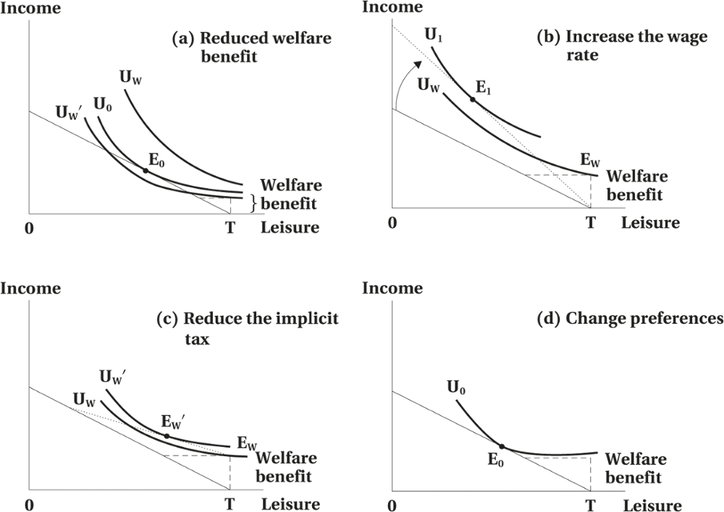
Demogrants, Welfare, and Wage Subsidies
Figure 3.3 Other Work Incentive Effects of Welfare Programs
© 2021 MCGRAW-HILL EDUCATION LTD.
3 - <number>

Slide 19
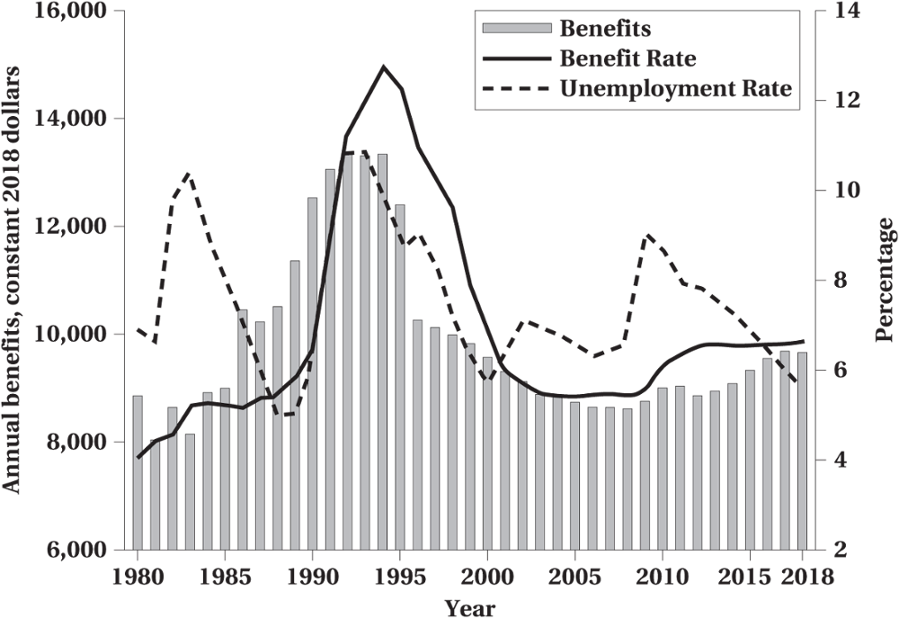
Demogrants, Welfare, and Wage Subsidies
Figure 3.4 Welfare Benefits, Beneficiaries, and Labour Market Conditions, Ontario
© 2021 MCGRAW-HILL EDUCATION LTD.
3 - <number>

Slide 20
Demogrants, Welfare, and Wage Subsidies
Negative Income Tax
Income guarantee
Implicit tax rate of less than 100%
Recipients receive more from the guarantee than they will pay out in taxes
  Child Tax Credit
  Guaranteed Income Supplement
  Y = G + (1 - t)E
  Where: G = Guaranteed Income
  t = Implicit Tax Rate
  E = Labor Market Earnings
© 2021 MCGRAW-HILL EDUCATION LTD.
3 - <number>

Slide 21
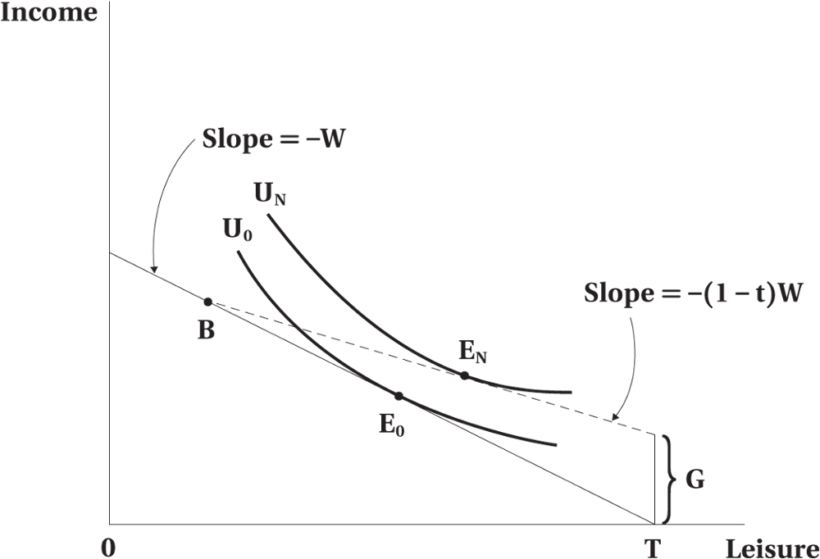
Demogrants, Welfare, and Wage Subsidies
Figure 3.5 Work Incentive Effects of a Negative Income Tax
© 2021 MCGRAW-HILL EDUCATION LTD.
3 - <number>

Slide 22
Demogrants, Welfare, and Wage Subsidies
Work Incentive Effects of a Negative Income Tax
Work incentives will be reduced.
The reduction in labour supply may have other desirable side effects.
It may be used to replace some welfare programs that have even larger adverse incentive effects.
© 2021 MCGRAW-HILL EDUCATION LTD.
3 - <number>

Slide 23
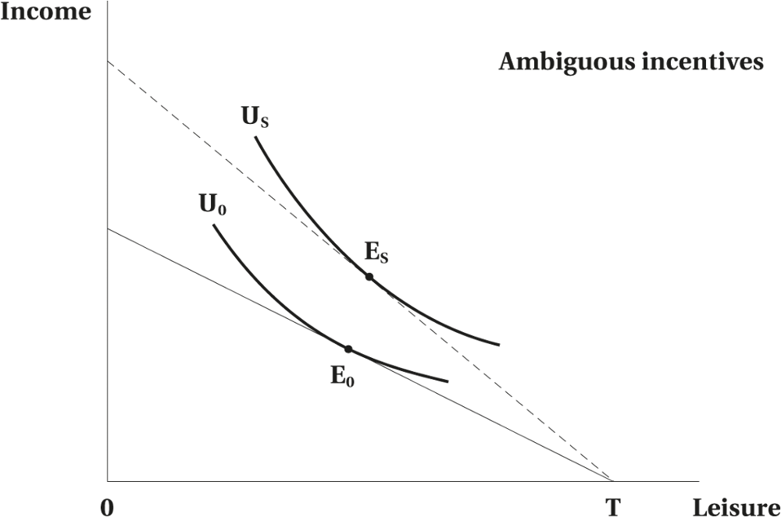
Demogrants, Welfare, and Wage Subsidies
Figure 3.6 Work Incentive Effects of a Wage Subsidy
© 2021 MCGRAW-HILL EDUCATION LTD.
3 - <number>

Slide 24
Demogrants, Welfare, and Wage Subsidies
Work Incentive Effects of a Wage Subsidy
Theoretically indeterminate
Adverse effects of wage subsidy are not as great as those of the negative income tax
Disadvantage: does nothing for the income of those who are unable to work
© 2021 MCGRAW-HILL EDUCATION LTD.
3 - <number>

Slide 25
Demogrants, Welfare, and Wage Subsidies
Refundable Tax Credit
A new “income-tested” wage subsidy program used in both US and Canada to reduce the cost associated with the pure wage subsidy programs
It is a refundable tax credit or subsidy that is paid irrespective of other income taxes paid by the individuals
© 2021 MCGRAW-HILL EDUCATION LTD.
3 - <number>

Slide 26
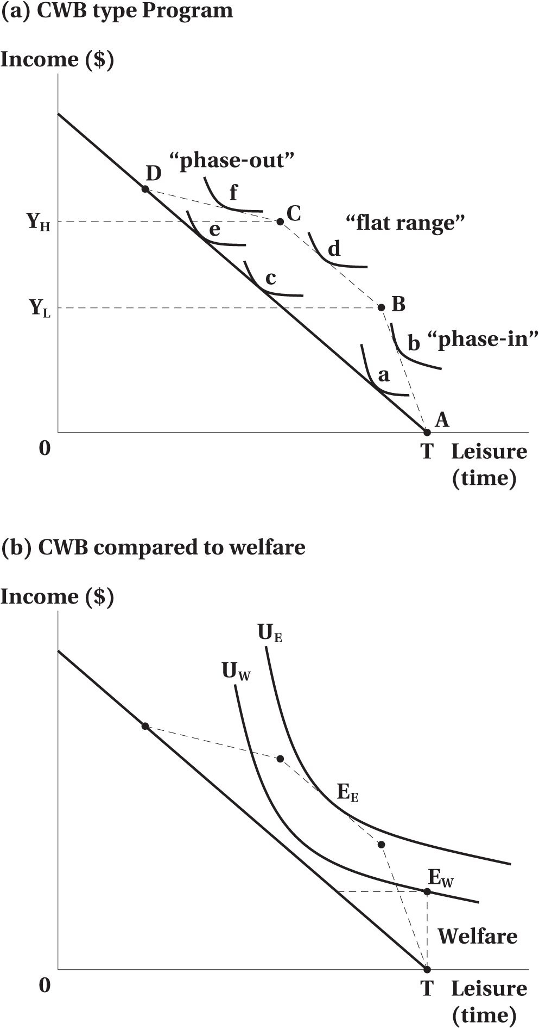
Demogrants, Welfare, and Wage Subsidies
Figure 3.7 Work Incentives of a Refundable Tax Credit
© 2021 MCGRAW-HILL EDUCATION LTD.
3 - <number>

Slide 27
Demogrants, Welfare, and Wage Subsidies
Work Incentives of a Refundable Tax Credit
The phase-in section is similar to a standard wage subsidy. The substitution effect increases work effort while the income effect reduces work effort. The overall impact on work effort is ambiguous.
In the flat range, the program exerts only an income effect and labour supply is reduced, assuming leisure is a normal good.
The phase-out section is like a negative income tax. The substitution and income effect reduce work effort. While the net effects on hours worked may be ambiguous, the effect on participation is clearer.
© 2021 MCGRAW-HILL EDUCATION LTD.
3 - <number>

Slide 28
Unemployment Insurance
Unemployment Insurance
Canada’s unemployment insurance program, known as Employment Insurance (EI) since 1996, is the largest income security program for non-elderly individuals in the country.
The amount of income replacement rate is 55% of lost earning, subject to a maximum.
The duration of benefit ranges from 14 to 45 weeks, depending on the regional rate of unemployment.
In order to qualify for the benefits, individuals must have worked between 420 and 700 hours, the equivalent of 12–20 weeks at 35 hours per week, again depending on the unemployment rate of the region.
© 2021 MCGRAW-HILL EDUCATION LTD.
3 - <number>

Slide 29
Unemployment Insurance
Worked Example
Unemployment Insurance and Work Incentives
Recipients receive 60 percent of their weekly pay in the case of unemployment
It requires a minimum of 14 weeks of employment in order to qualify for benefits.
The maximum period of receiving benefits is 20 weeks
© 2021 MCGRAW-HILL EDUCATION LTD.
3 - <number>

Slide 30
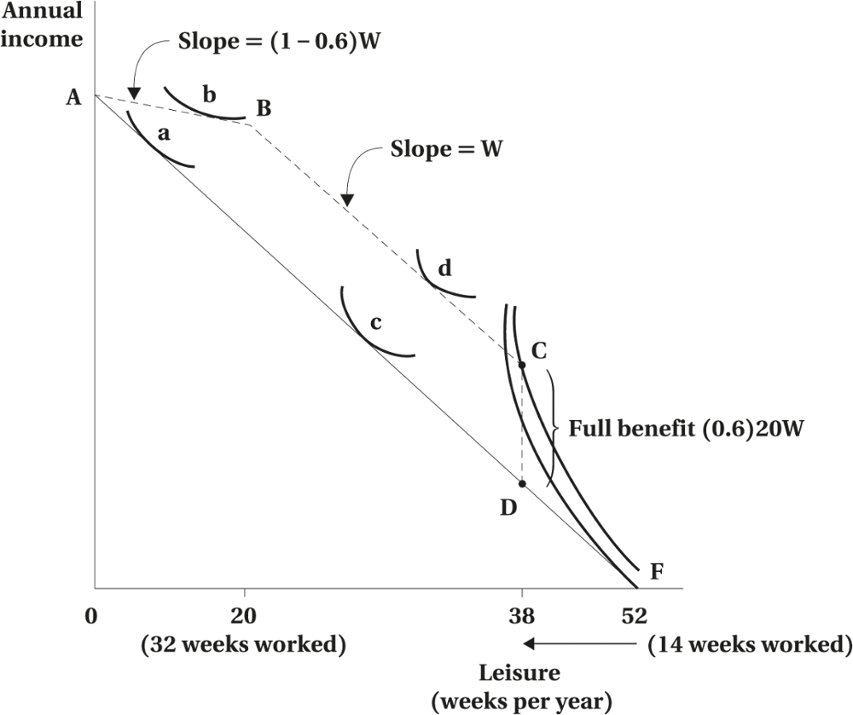
Unemployment Insurance
Income Constraint for a Simplified Unemployment Insurance Scheme
© 2021 MCGRAW-HILL EDUCATION LTD.
3 - <number>

Slide 31
Disability and Workers’ Compensation
Effect of a Disability
Budget constraint or preference curve could be altered
Factors to be considered:
  hours able to work
  medical expenses
  reduced ability to earn wages
  disutility of labour market vs. other activities
© 2021 MCGRAW-HILL EDUCATION LTD.
3 - <number>

Slide 32
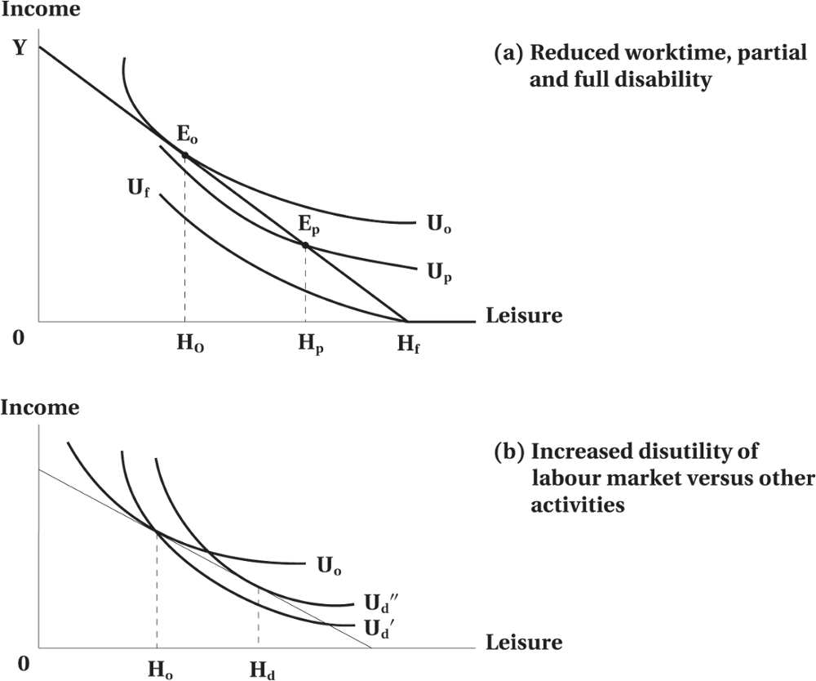
Disability and Workers’ Compensation
Figure 3.8 Effect of Disability
© 2021 MCGRAW-HILL EDUCATION LTD.
3 - <number>

Slide 33
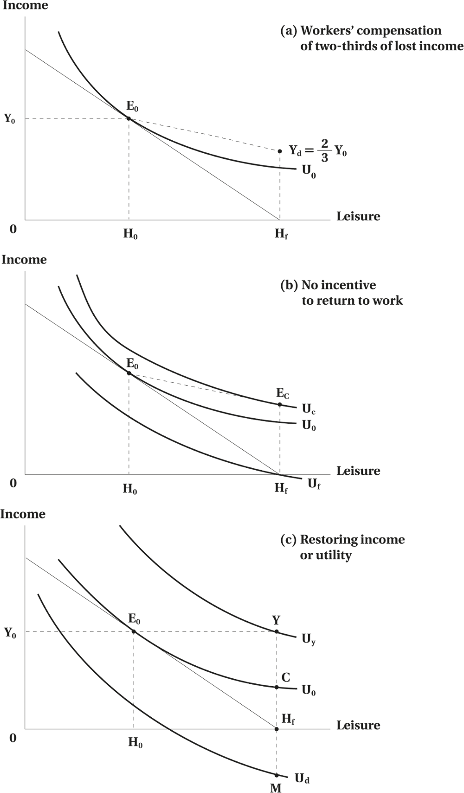
Disability and Workers’ Compensation
Figure 3.9 Effect of Compensation
© 2021 MCGRAW-HILL EDUCATION LTD.
3 - <number>

Slide 34
Child Care Subsidy
Daycare costs can be modelled as a special case of fixed costs associated with working
Effect of childcare subsidy
  Fixed costs may increase reservation wage
  Fixed costs may also affect hours-of-work
    Increased hours for those who participate
    Create a discontinuity in labour supply
© 2021 MCGRAW-HILL EDUCATION LTD.
3 - <number>

Slide 35
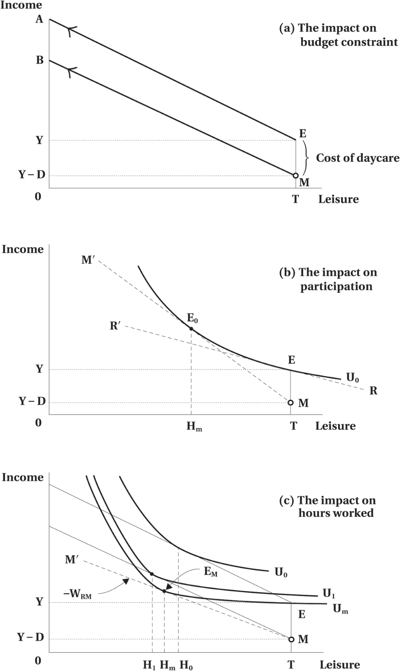
Child Care Subsidy
Figure 3.10 The Effect of Child Care Costs on Labour Supply
© 2021 MCGRAW-HILL EDUCATION LTD.
3 - <number>

Slide 36
Child Care Subsidy
Encourages labour force participation and part-time work
Reduces the hours of work for those already participating
© 2021 MCGRAW-HILL EDUCATION LTD.
3 - <number>

Slide 37
Chapter Summary
Income maintenance schemes are designed to top-up low incomes, which can arise for any of a variety of reasons, be permanent or transitory, and may be due either to low wages or hours.
The labour supply framework is a useful way to analyze work incentive effects.
Demogrants are pure lump-sum transfers, based only on immutable individual characteristics like age or sex.
Welfare programs are designed to increase the income of individuals with low income. The degree to which they have adverse work incentive effects depends on how strictly benefits are reduced in response to higher earnings.
© 2021 MCGRAW-HILL EDUCATION LTD.
3 - <number>

Slide 38
Chapter Summary
Negative income taxes, or guaranteed annual income programs, are generalizations of welfare programs.
Wage subsidies make work more attractive but are very expensive unless they are targeted to the working poor. One increasingly popular form of targeted work subsidy is delivered as a refundable tax credit.
Unemployment insurance is designed as an insurance scheme responding to short-run reductions in available hours of work, especially due to cyclical changes in labour market conditions.
Workers’ compensation is designed to address income losses arising from workplace injuries.
Childcare expenses can be modelled as fixed costs associated with working.
© 2021 MCGRAW-HILL EDUCATION LTD.
3 - <number>

